Slide 1
Welcome!
University of Scouting:
Life to Eagle Transition
Revision: February 2020
Eric Cutright: SM T1028, ASM T1029
Email: ericcutright@comcast.net
Useful Life to Eagle Resources: www.troop1028.org/advancement.html www.vahcbsa.org/MonticelloAdvance

Slide 2
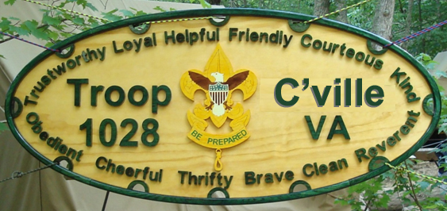
Seminar Objectives
Review the requirements for the Eagle Scout rank
Discuss Troop roles in Eagle Scout advancement
Describe the process for the Eagle Scout Service Project
Review the Eagle Scout application and the Scout’s responsibilities in getting it processed
Discuss the Eagle Scout Board of Review (BOR)
To help you understand the time commitment & be prepared
To answer any questions from Scouts, parents & leaders
Most importantly, to avoid any surprises !
  With bonus advice from Troop 1028/9, marked like this:
T1028/9 Advice

Slide 3
Eagle Scout Rank Requirements
Be active in your Troop *
Live by the Scout Oath and Law *
Earn 21 Merit Badges including 13 required*
Serve in leadership position(s) for 6 months since becoming a Life Scout *
Give leadership to others in a service project *
Take part in a Unit leader conference *
Successfully complete an Eagle Scout Board of Review
* These requirements must be completed prior to 18th birthday!
See Mr. Eric’s handy dandy step-by-step checklist for 1 - 7!
Note: no Unit may add, modify, or subtract requirements

Slide 4
Troop Roles in Eagle Scout Advancement
Troop 1028/9 Advice

Slide 5
Troop Roles in Eagle Scout Advancement
Many Troops establish an Eagle Project Committee (EPC) or something similar to keep track of current and planned Eagle Scout Service Projects
The EPC provides feedback on the Project Proposal to ensure quality before it is submitted to the District
The EPC works with Eagle candidates to ensure their projects are feasible, planning is sound, and they are progressing well
The EPC ensures that a candidate is READY before buying supplies or announcing any work days
The EPC helps Scouts find a project coach with required expertise to fit the selected project

Slide 6
Troop 1028/9 Eagle Project Committee (EPC)
Troops 1028 and 1029 have been operating an effective EPC for several years to manage the process:
  Mike Funk, ASM – Life to Eagle Mentor
  Bob Frysinger, Troop Committee member
  Bill Wolfe, Troop Advancement Chair
  Ginny Thompson, Troop Committee Chair
  Eric Cutright, Scoutmaster Troop 1028
  Tom Zakielarz, Scoutmaster Troop 1029
  Kim Reisinger, Incoming Scoutmaster Troop 1029
We tell our Scouts - Keep the EPC informed and be prepared for constructive comments – it will help YOU

Slide 7
Eagle Scout Service Project Pitfalls to Avoid
The 17+++ Scout wants to ram through a “quickie” project
  Unit leadership needs to be in contact before this happens
Unit leadership approves a project that cannot be approved by the District reviewer
  Before the Scout spends too much time on an unworkable project, check the feasibility and steer them in the right direction
Unit leadership should not sign a project unless it is complete
  Do not leave it to the Board of Review to judge a project’s successful completion!
Most, if not all, problems are avoidable!

Slide 8
Eagle Requirements 1 through 4

Slide 9
Eagle Requirement 1:
Be active in your Troop
Be active in your Troop for six months after achieving Life rank
How is “active in your Troop” determined?
  The Scout is registered
  The Scout is in good standing
  The Scout meets the unit’s reasonable expectations; or if not, a lesser level of activity is explained and accepted
  T1028/9: The Troop 1028/9 Committee defines active as attending 50% of meetings and at least 3 activities in a 6 month period
T1028/9 Advice

Slide 10
Eagle Requirement 2:
Live by the Scout Oath & Law
As a Life Scout, demonstrate Scout Spirit by living the Scout Oath and Scout Law
Tell how you have done your duty to God, how you have lived the Scout Oath and Scout Law in your everyday life, and how your understanding of the Scout Oath and Scout Law will guide your life in the future
List on your Eagle Scout Rank Application 5 to 6 individuals who know you personally and would be willing to provide a recommendation on your behalf

Slide 11
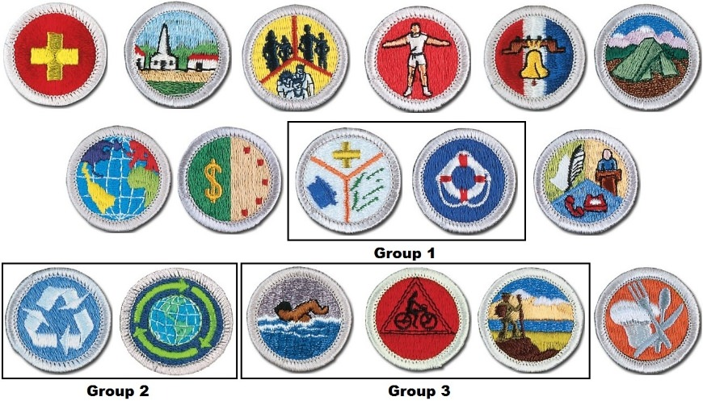
Eagle Requirement 3:
Earn a total of 21 Merit Badges including 13 required
First Aid
Citizenship in the Community
Citizenship in the Nation
Citizenship in the World
Cooking
Communication
Personal Fitness (90 day)
Emergency Preparedness OR Lifesaving
Environmental Science OR Sustainability
Personal Management (90 day)
Swimming OR Hiking OR Cycling
Camping
Family Life (90 day)

Slide 12
Warning! Some Merit Badges are lengthy and cannot be rushed
If the Merit Badge requirement says:
  Meet with your counselor …
  Keep records for three months …
  You must meet with your counselor AT LEAST 3 months prior to your 18th birthday or you can’t complete the Merit Badge in time!
You cannot keep a record of your budget and spending for three months in only three weeks
To ask anyone to backdate merit badge requirements because of poor planning would violate the principles of Scouts BSA and invalidate any Eagle rank presented as a result of that action

Slide 13
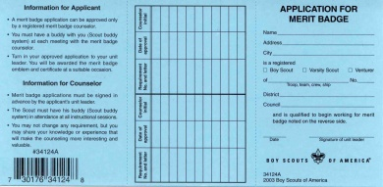
Maintaining Records - Keep your Blue Cards !!
Part of being an Eagle Scout is showing adults you are a responsible person and one demonstration of this is the ability to keep track of your accomplishments
Your Unit is expected to record merit badges in a timely manner, but it is the candidate’s responsibility (not a parent, guardian, mentor, coach or Unit committee) to have a record of each earned Merit Badge

Slide 14
Eagle Requirement 4:
Active Leadership
While a Life Scout, serve actively in your Troop for six months in one or more of the following positions (consecutively but not simultaneously):
  Senior Patrol Leader
  Assistant Senior Patrol Leader
  Patrol Leader
  Troop Guide
  Instructor
  Den Chief
  Troop Historian
  Troop Quartermaster
You must do the job, not just wear the patch!
  Webmaster
  Troop Scribe
  Troop Librarian
  Junior Assistant Scoutmaster
  Chaplain Aide
  Outdoor Ethics Guide
  Troop Order of the Arrow Representative*
  Note: Troop may only have 1 OA rep at a time approved by chapter / lodge

Slide 15
Eagle Requirement 5:
The Eagle Scout Service Project

Slide 16
The Eagle Scout Service Project
While a Life Scout, plan, develop, and give leadership to others in a service project helpful to any religious institution, any school, or your community
The project must benefit an organization other than
Scouts BSA
A project proposal must be approved by the organization benefiting from the effort, your Scoutmaster and Unit Committee, and the Council or District before you start
You MUST use the Eagle Scout Service Project Workbook, Scouts BSA publication number 512-927

Slide 17
What Makes an Acceptable
Eagle Scout Service Project?
Does the project provide opportunity to show leadership?
Is it feasible within a reasonable time frame with reasonable cost?
Will safety issues be addressed?
What are the action steps for detailed planning?
Is the candidate is on the right track for a positive experience?

Slide 18
Answers to Common Service Project Questions
Routine labor is NOT an Eagle Scout Service Project
The project beneﬁciary does not have to be a registered
non-proﬁt organization
There is no requirement for a project to have lasting value
Give “leadership to others” means at least two people besides the Scout
  The Scout must be able to show leadership
No Unit, District, Council, or individual can place any requirement on the number of hours spent on a project

Slide 19
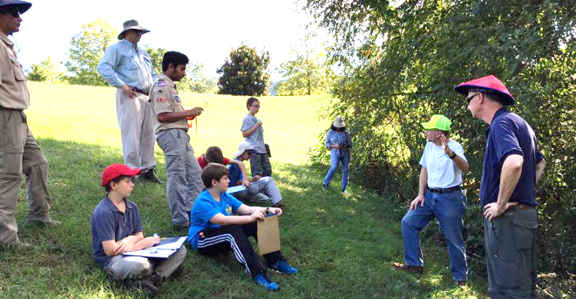
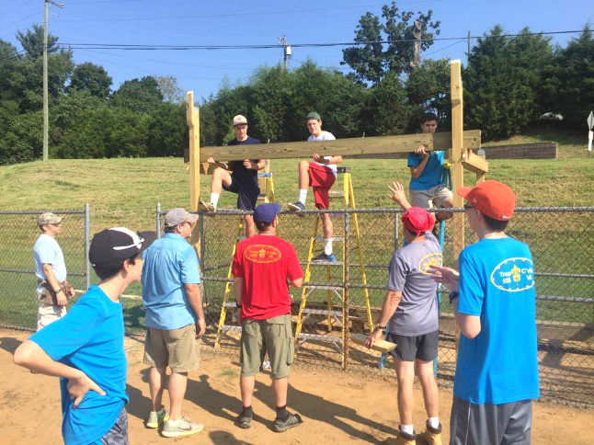
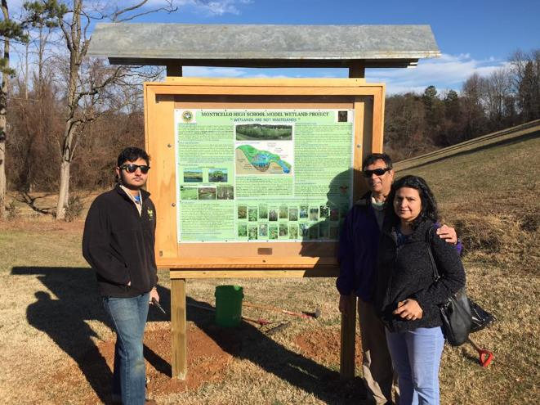
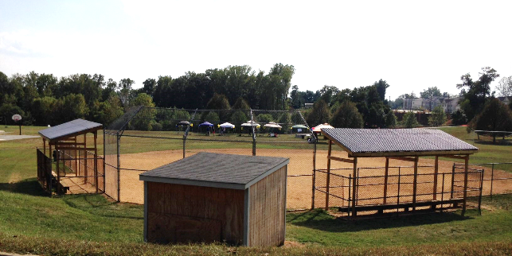
Sample Eagle Scout Service Projects – Be creative !
Wetlands Cleanup and Display
Baseball Dugouts

Slide 20
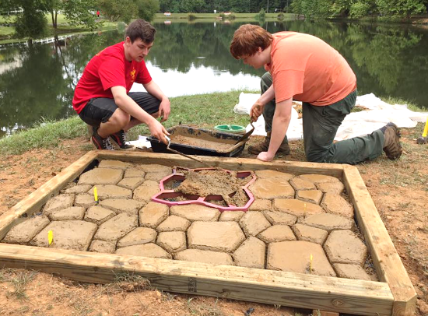
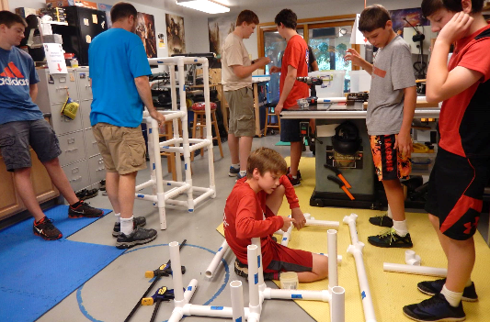
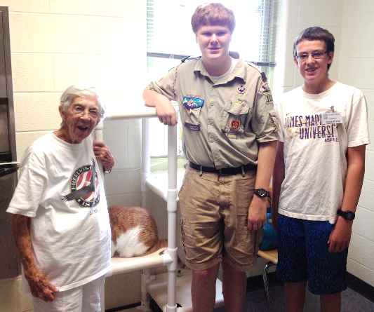
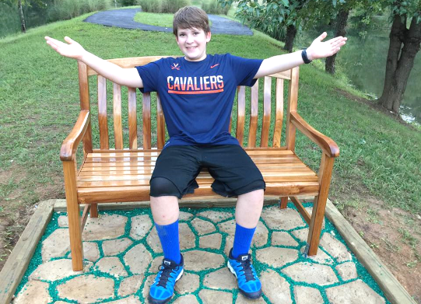
Sample Eagle Scout Service Projects – Be creative !
Cat Trees for SPCA
Lakeside Benches

Slide 21
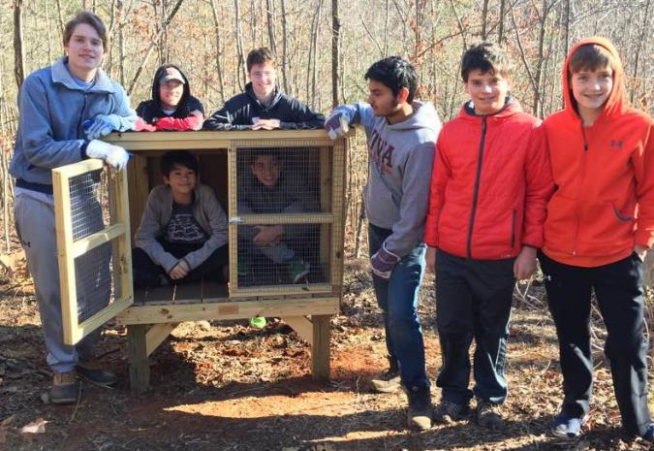
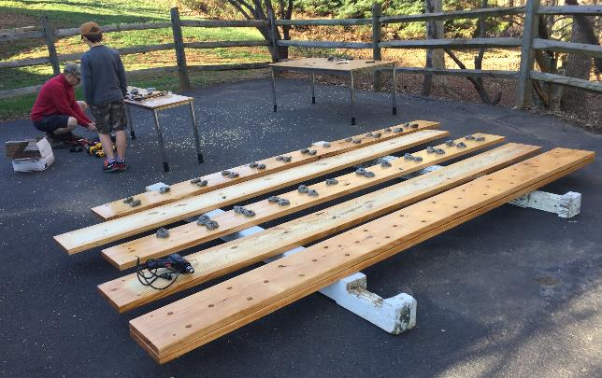

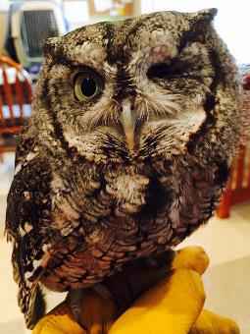
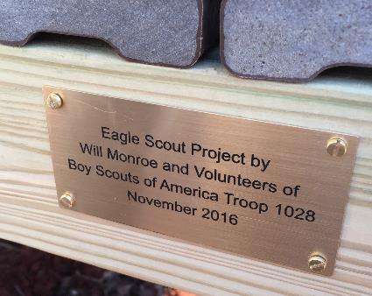
Sample Eagle Scout Service Projects – Be creative !
School Exercise Wall
Wildlife Rescue Shelters
Trail Overlooks

Slide 22
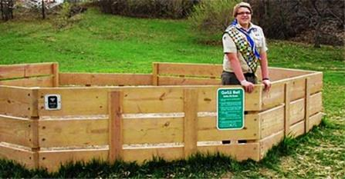
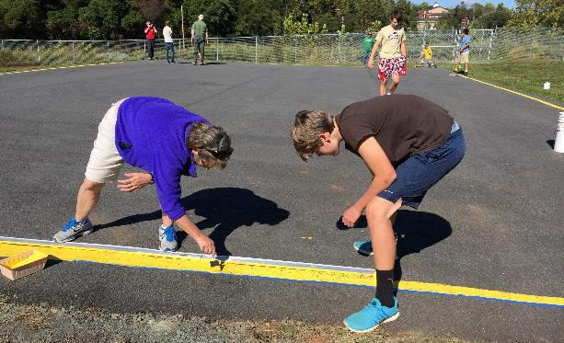
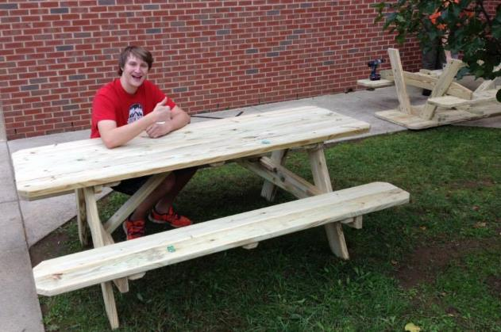
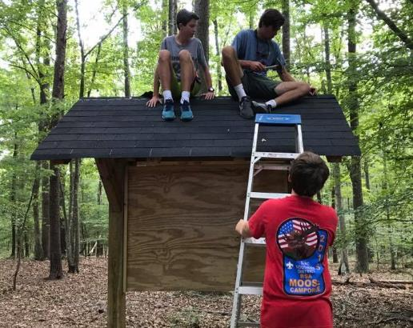
Sample Eagle Scout Service Projects – Be creative !
Gaga Ball Pit
Playground Upgrades
Kindergarten
Picnic Tables
Trail
Kiosks

Slide 23
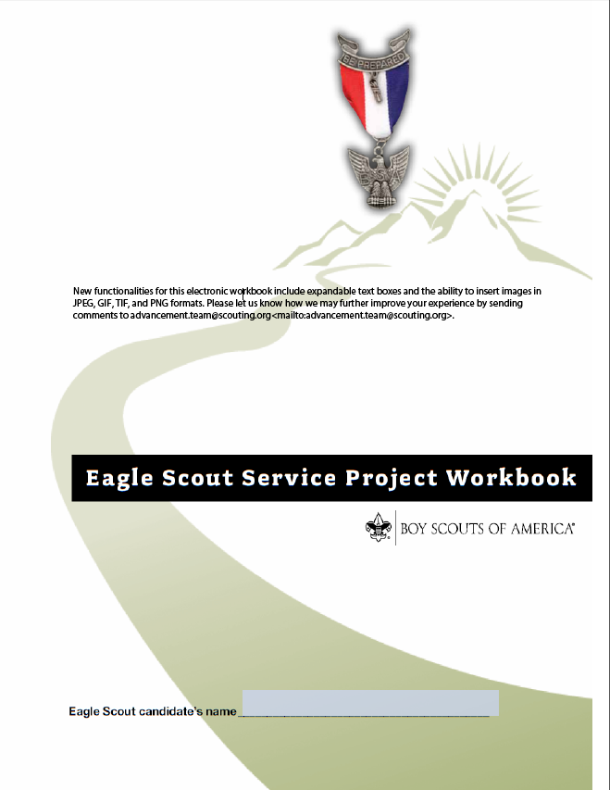
Use the Eagle Scout Service Project Workbook
Use the latest pdf version!
  https://www.scouting.org/programs/scouts-bsa/advancement-and-awards/eagle-scout-workbook/
Fill it out electronically for easy editing and rework – DO NOT hand-write
Requires FREE Acrobat Reader 9 – don’t be ripped off by “subscription pdfs”
There is very helpful info in the intro!
The file size can get huge – try “printing to pdf” with a different file name to make it smaller for emailing.

Slide 24
Using the Eagle Scout Service Project Workbook
The Eagle Scout Service Project Workbook is divided into easily referenced forms:
  Project Proposal
  Project Plan
  Fundraising Application
  Project Report
Following the project report you will find “Navigating the Eagle Scout Service Project” information sheet to discuss with your project beneficiary
You are strongly encouraged to work with an Eagle Scout Service Project Coach to avoid problems

Slide 25
Eagle Scout Service Project Workbook Sequence
First: Complete the proposal and fundraising sections
  Project Proposal
  Fundraising Application
  Give “Navigating the Eagle Scout Service Project” to your beneficiary, discuss with them
Wait for District approval of your Project Proposal
Second: Complete the Project Plan well before your workdays start
  Project Plan
Third: Complete the Project Report after your project is complete
  Project Report

Slide 26
Eagle Scout Service Project Steps:
Project Proposal
Complete the Project Proposal section, addressing these points:
  Contact information
  Project description and benefit
  Giving leadership
  Materials, supplies, tools, and permits/permissions needed
  Preliminary cost estimate
  Anticipated project phases
  Logistics and safety measures needed
  Action steps for your project plan
  Approval signatures

Slide 27
Eagle Scout Service Project Steps:
Fundraising Application
If you are fundraising from external sources, complete the Fundraising section
  Projects themselves may not be fundraisers
  Scouts BSA prefers projects be done at little or no cost
  Fundraising is for the beneficiary and not Scouts BSA
  If you have an expensive project, allow time to raise funds!
  NOTE: If your fundraising effort involves contributions only from the beneficiary, or you, your parents or relatives, your Unit or its Chartered Organization, or parents or members in your Unit, then you do NOT need a fundraising application

Slide 28
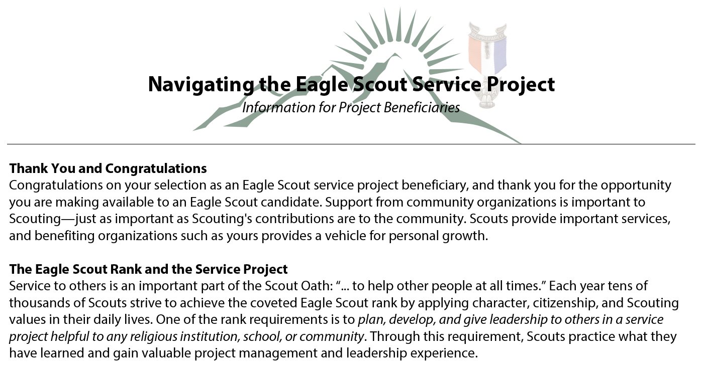
Eagle Scout Service Project Steps:
Discuss with Beneficiary
Give “Navigating the Eagle Scout Service Project” to your beneficiary, discuss with them
  Explains the Scout and Beneficiary roles in the project
  Outlines the entire process for Beneficiary understanding

Slide 29
Eagle Scout Service Project Steps:
Get Approvals Before you Proceed
Have the Project Proposal and Fundraising sections approved and signed by your Scoutmaster, your Committee Chair, the project Beneficiary, and then and only then submit to your District Approver
  Massanutten: Kemper Dadisman, kempshome@aol.com
  Monticello: Jay Fox, jayfox8x@gmail.com
  Southern: Judy Goodbar, toadrunfarms@embarqmail.com
  Valley: Jerry Sheffer, jshefsvr@verizon.net
Scouts in Monticello, before you start working on your proposal, please read the letter from the District Reviewer found at https://www.vahcbsa.org/MonticelloAdvance

Slide 30
Eagle Scout Service Project Steps: Project Plan
AFTER receiving District approval and BEFORE starting your project, complete the Project Plan
  The Project Plan is a tool for your use - no one approves it, although your project beneficiary has the authority to review it and require changes in it
  Your Project Plan can be VERY important in showing your Eagle Scout Board of Review that you have planned and developed your project as required
  You are strongly encouraged to share your Project Plan with an Eagle Scout Service Project coach
    Doing so can help you avoid many problems
    Check with the Council or District approver to learn how project coaches are designated in your community

Slide 31
Developing the Project Plan
Format for the Project Plan
  Did you have to make any changes from the Proposal?
  What is the present condition of the worksite?
  What are the project phases?
  What work processes will be used?
  What materials, supplies, tools, and special permits/permissions are needed?
  What is your updated cost estimate?
  How will you give leadership?
  What logistics and safety measures are needed?
  What are your contingency plans for things like bad weather?
  What comments did you receive from your Project Coach?

Slide 32
The Project Plan: Working with your Project Coach
The Eagle Project Coach is the subject matter expert on the Service Project, and can be a huge help:
Meet with your coach after the project proposal has been approved but before work begins
Explain to your coach how you will plan the project
Review health & safety issues
Prepare a detailed plan and discuss with your coach; address any weaknesses in the plan before starting work
After working out details with your coach, share your project plan with your beneficiary
Keep your coach involved during your project

Slide 33
Be Prepared !
Good Planning is Key
Don’t make expensive mistakes! Confirm your shopping list with your project coach BEFORE you purchase anything to make sure you are buying the correct materials in correct amounts
A detailed drawing/plan can be a tremendous help:
  Clearly show parts, materials, and dimensions for a well-organized “parts cutting” session - remember to “measure twice and cut once”
  Clearly show/demonstrate the detailed assembly process so that Scouts can successfully assemble the project with minimal direction
Before announcing workdays, confirm your plans with the Troop to avoid event conflicts and provide the following information:
  How many people do you need?
  What skills are required?
  How will you divide up the work?
  What is your safety plan?

Slide 34
Eagle Scout Service Project Steps: Carry Out Your Project
Schedule your workdays and carry out your project
  The key is providing LEADERSHIP throughout your project, from planning/fundraising all the way through the actual work
  On your work day, YOU should ONLY direct the process and NOT do any actual work – the point is to show LEADERSHIP
    Think about who may show up and what tasks they can work on safely and efficiently – people have different skills and abilities
    How will you keep everyone busy and productive?
  You must provide safety training and all supervision
  Give a safety briefing to all participants before any work begins
    Where is the first aid kit, who is CPR certified, who can call 911, where are the emergency exits, what are the safety precautions for tools you will be using, where are protective devices (ear plugs, dust masks, safety glasses, fire extinguisher)?

Slide 35
Eagle Scout Service Project Steps: Write the Project Report
After you complete your project, write the Project Report:
  Project description
  Observations – what went well? What didn’t?
  What changes did you have to make?
  How did you give leadership?
  What work processes will be used?
  Were there any issues with materials, supplies, or tools?
  How many volunteers helped and how long did they work?
  How did your funding work out?
  Attach photos and other documentation
  Authorized signatures – Scout, Beneficiary, Unit leader

Slide 36
Eagle Requirements 6 and 7

Slide 37
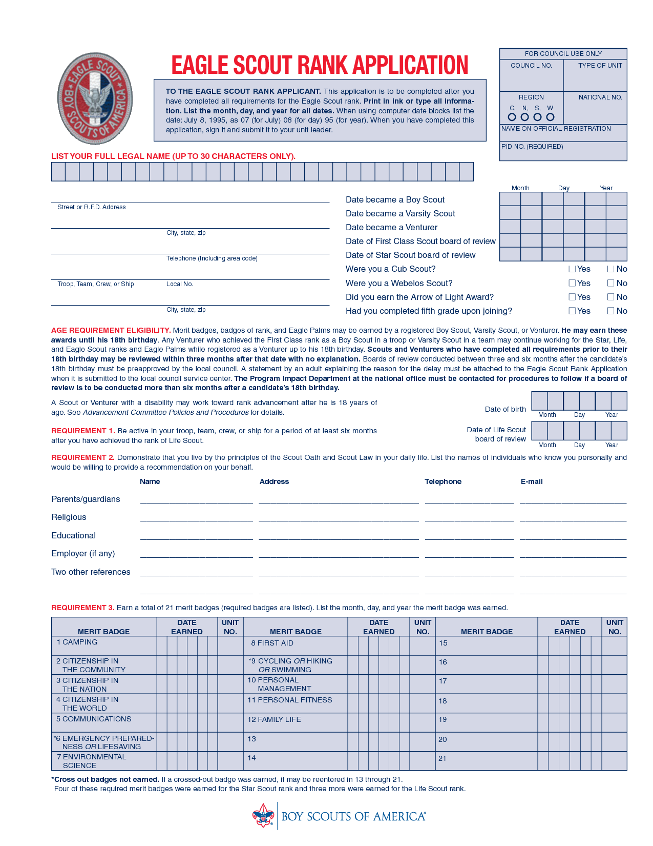
The Eagle Application
All but one requirement on the Eagle Scout Rank Application must be completed BEFORE the 18th birthday
The only requirement allowed after age 18 is the Eagle Scout Board of Review (BOR)
Reqt 6: You must write a separate Life Purpose Paper
Reqt 2: You will need 5 to 6 recommendations for your BOR

Slide 38
The Eagle Application:
The Life Purpose Paper
The Life Purpose Paper requirement:
  In preparation for your board of review, prepare and attach to your Eagle Scout Rank Application a statement of your ambitions and life purpose and a listing of positions held in your religious institution, school, camp, community, or other organizations, during which you demonstrated leadership skills. Include honors and awards received during this service.
This will be read by several people who don’t know you at all:
  Think carefully about how to present yourself to give a good impression
  Keep the Scout Oath and Law in mind as your guide
  Think about your future – plus, how do you plan to give back to Scouting per the Eagle Scout charge?

Slide 39
Eagle Requirement 6:
The Scoutmaster Conference
The Scoutmaster (or Unit leader) has two main goals for the Scoutmaster Conference:
  To review the Scout’s career in Scouts BSA and to get direct feedback on the highlights and lowlights to improve the Unit
  To help the Scout be prepared for the Eagle Board of Review
Note that Scouts participate in the Scoutmaster Conference
  It is not a “test” and there is no pass/fail given
The Scoutmaster Conference does NOT have to be the final step before the Board of Review
  Scouts on a tight schedule to complete everything before age 18 may need to “fit in” the Scoutmaster Conference

Slide 40
The Eagle Rank Application:
BSA Local Council Verification
Review your Eagle Rank Application at your Scoutmaster Conference, and have your Scoutmaster sign it
Contact the registrar at the Waynesboro Service Center to request a meeting time for records verification
  If there is a discrepancy, get it resolved quickly
Don’t take any chances - hand deliver your application with the original signatures to the Service Center for verification
Wait for the registrar’s signature – DO NOT LEAVE any of your materials there

Slide 41
Eagle Requirement 7:
The Eagle Board of Review
The Eagle candidate requests the Eagle Board of Review through his/her Troop Advancement Chair
The Advancement Chair schedules the BOR with the District representative
The following must be completed and sent to the District representative to schedule an Eagle Board of Review:
  Eagle Scout Service Project Workbook with ALL required signatures
  Eagle Rank Application with ALL required signatures and references
  Life Purpose Paper

Slide 42
References for Board of Review
The Unit obtains recommendations from the references listed on the Eagle Scout Rank Application
  This may be done by letter, form, or phone call
  Most Units have an electronic template for the letter
The Scout should request letters of recommendation be sent to the Unit Advancement Chair and kept sealed until the BOR
  Recommendations are confidential & not shared with the Scout
  Recommendations are for the Board of Review only and are not kept (shredded after BOR)
  If letters are not received in a timely fashion before the BOR, the Unit will follow-up with an email or phone call, but this is not the Scout’s responsibility and is not held against the Scout

Slide 43
AFTER the Board of Review:
Turn in your Completed Application
After the BOR signs your Eagle application, it is YOUR responsibility to turn it in!
Don’t take any chances - hand deliver your final application with the original signatures to the Waynesboro Service Center for submission to National
  MAKE A COPY FIRST!
  Leave your completed Eagle Service Project Workbook and all supporting materials with the application
Waynesboro will notify the Troop when your Eagle bling has arrived, and will get all your materials back at that time

Slide 44
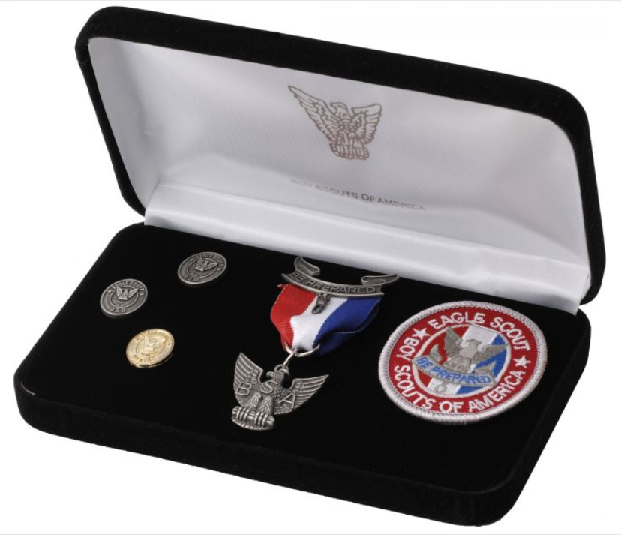

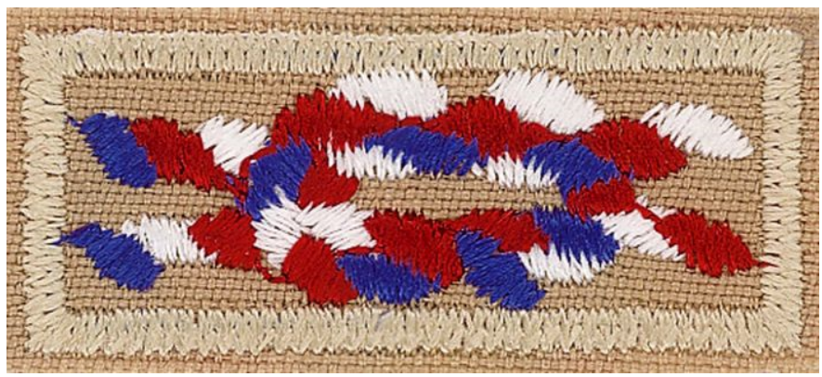
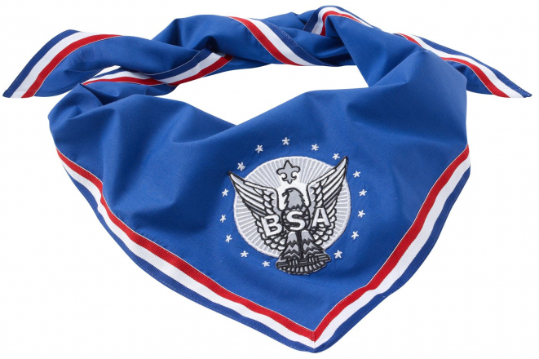
Time to Celebrate!
Plan your Eagle Court of Honor
Don’t set any dates for your
Court of Honor until your
Eagle bling has arrived
  Eagle pin & patch
  Mother and father pins
  Mentor pin
  Optional: Grandparent Pin &
  Eagle Knot if you are over 18
  Optional: Eagle Neckerchief
  (one typ. is awarded at Council Award Dinner)
Your Advancement Chair can request letters of
congratulation from local, state, and national politicians
Most Troops have a standard outline for an Eagle Scout
Court of Honor, but YOU make it what YOU want

Slide 45
Thank You!

